Slide 1



Digital Logic Design
Semester II
FY
Course Code
316U06C203
Jan – May 2026

Slide 2


Combinational Circuits

Slide 3
Contents
Half and Full Adder,
Half and Full Subtractor,
Four Bit Binary Adder,
Four Bit Binary Subtractor (1’s and 2’s complement method)
Controller Adder / Subtractor
Multiplexers and multiplexer trees,
Decoders
Encoders
One bit, Two-bit ,4-bit Magnitude Comparator

Slide 4
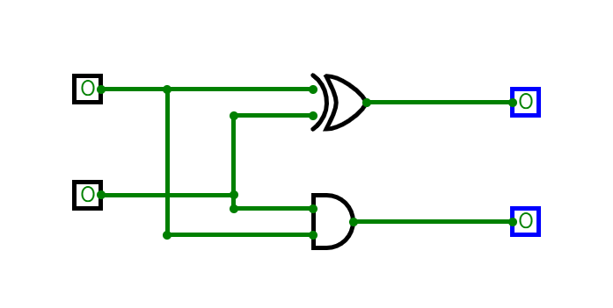
Half Adder
Half adder Truth Table
Half adder
Sum = Σ m (1,2) = A xor B
Carry = Σ m (3) = A and B
A | B | Sum | Cy
0 | 0 | 0 | 0
0 | 1 | 1 | 0
1 | 0 | 1 | 0
1 | 1 | 0 | 1

Slide 5
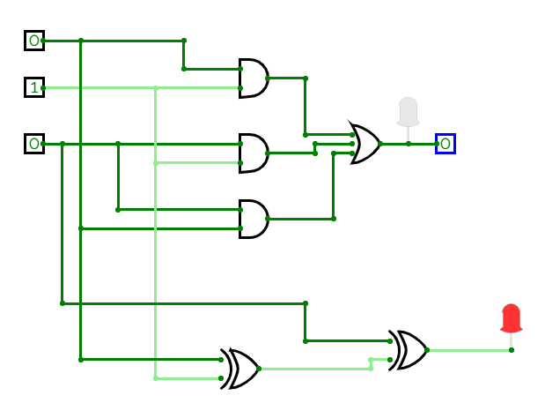
Full Adders
Full adder
Carry = Σ m (3,5,6,7)
= A.B + A.Cin+ B.Cin
Sum = Σ m (1,2,4,7)
= A xor B xor Cin
Full adder Truth Table
A | B | Cin | Sum | Cy
0 | 0 | 0 | 0 | 0
0 | 0 | 1 | 1 | 0
0 | 1 | 0 | 1 | 0
0 | 1 | 1 | 0 | 1
1 | 0 | 0 | 1 | 0
1 | 0 | 1 | 0 | 1
1 | 1 | 0 | 0 | 1
1 | 1 | 1 | 1 | 1

Slide 6
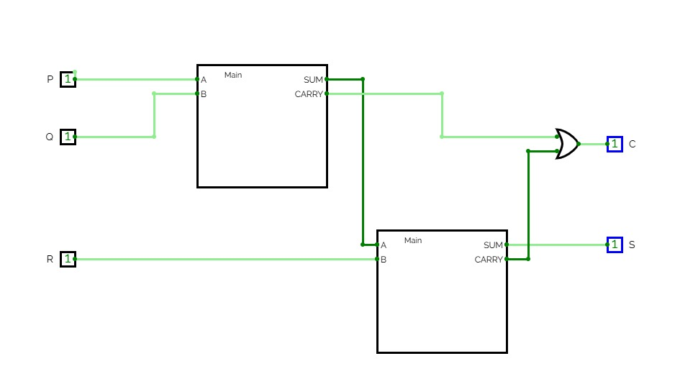
Full Adder using 2 half Adders
Half Adder: Sum = A xor B , Carry = A . B
Full Adder: Sum = A xor B xor Cin, Carry = AB +BCin+ A Cin
Full adder using 2 half adders
Carry = A.B + (A xor B) .Cin
Prove that it is same as AB +BCin+ A Cin

Slide 7
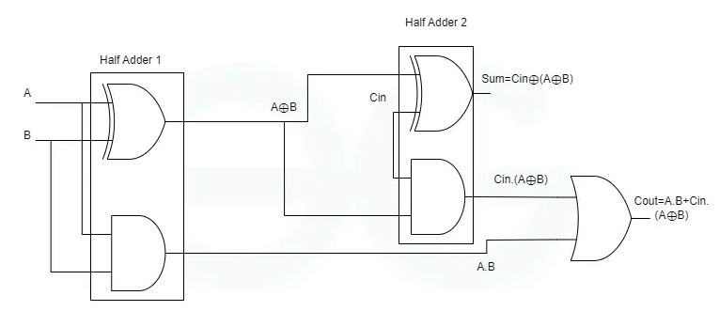
Full Adder using 2 half Adders

Slide 8
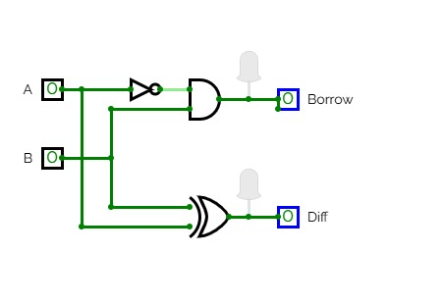
Half Subtractor
Diff = A XOR B , Bo = A’. B
A | B | Diff | Bo
0 | 0 | 0 | 0
0 | 1 | 1 | 1
1 | 0 | 1 | 0
1 | 1 | 0 | 0

Slide 9
Full Subtractor
Full Subtractor
Bout = Σ m (1,2,3,7)
Bout = A’B+ A’Bin + B Bin
Sum = Σ m (1,2,4,7)
= A xor B xor Bin
Full Subtractor Truth Table
A | B | Bin | Diff | Bo
0 | 0 | 0 | 0 | 0
0 | 0 | 1 | 1 | 1
0 | 1 | 0 | 1 | 1
0 | 1 | 1 | 0 | 1
1 | 0 | 0 | 1 | 0
1 | 0 | 1 | 0 | 0
1 | 1 | 0 | 0 | 0
1 | 1 | 1 | 1 | 1
AB/Bin | 00 | 01 | 11 | 10
0 | 0 | 1 | 0 | 0
1 | 1 | 1 | 1 | 0

Slide 10
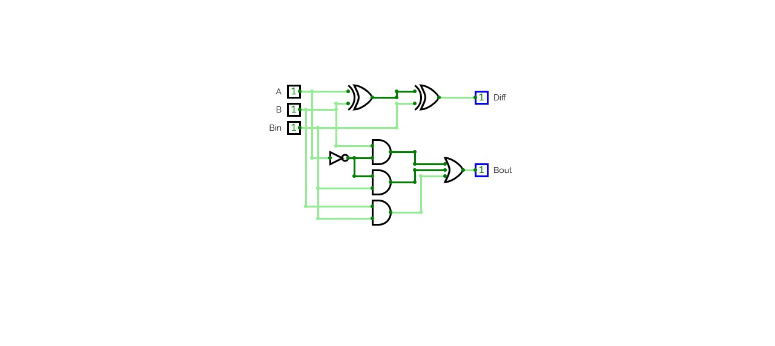
Full Subtractor
Full Subtractor
Bout = Σ m (1,2,3,7)
Bout = A’B+ A’Bin + B Bin
Sum = Σ m (1,2,4,7)
= A xor B xor Bin

Slide 11
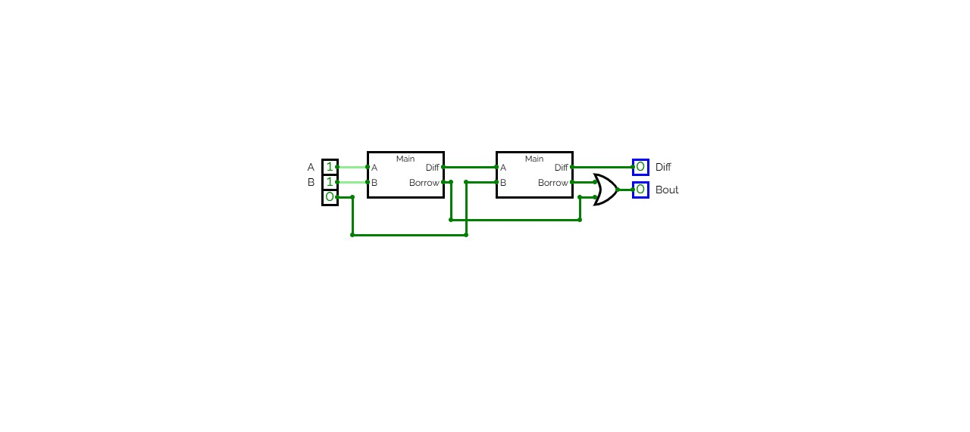
Full Subtractor using Half Subtractors
Diff = A XOR B XOR Bin
Bout =A’B + A’Bin + BBin
Full Subtractor Truth Table
A | B | Bin | Diff | Bo
0 | 0 | 0 | 0 | 0
0 | 0 | 1 | 1 | 1
0 | 1 | 0 | 1 | 1
0 | 1 | 1 | 0 | 1
1 | 0 | 0 | 1 | 0
1 | 0 | 1 | 0 | 0
1 | 1 | 0 | 0 | 0
1 | 1 | 1 | 1 | 1

Slide 12
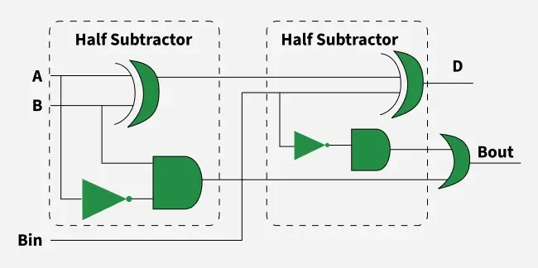
Full Subtractor using Half Subtractors

Slide 13
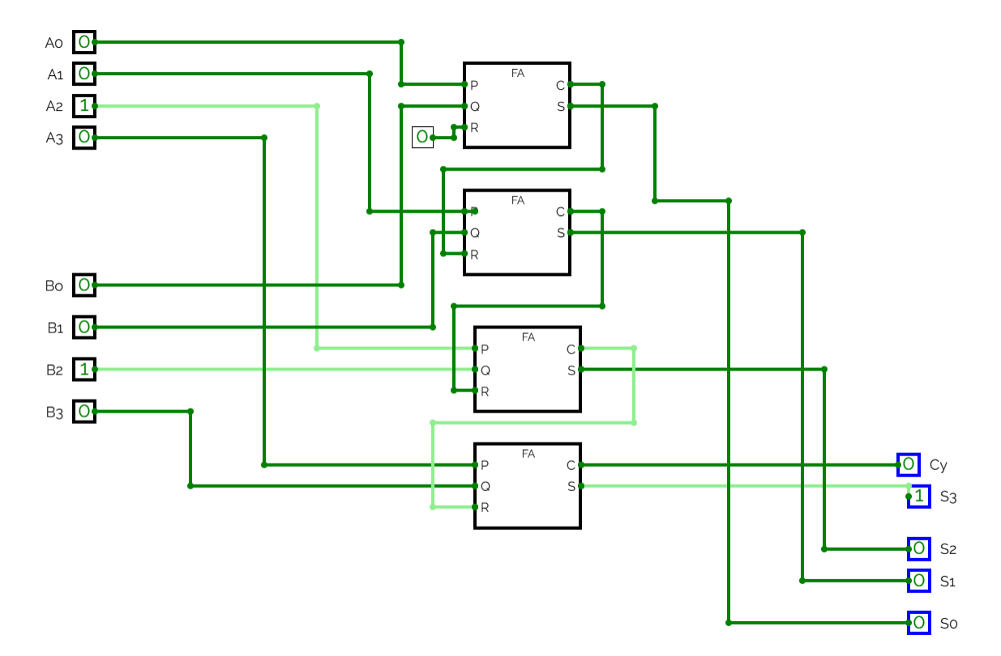
4 bit adder using full Adder

Slide 14
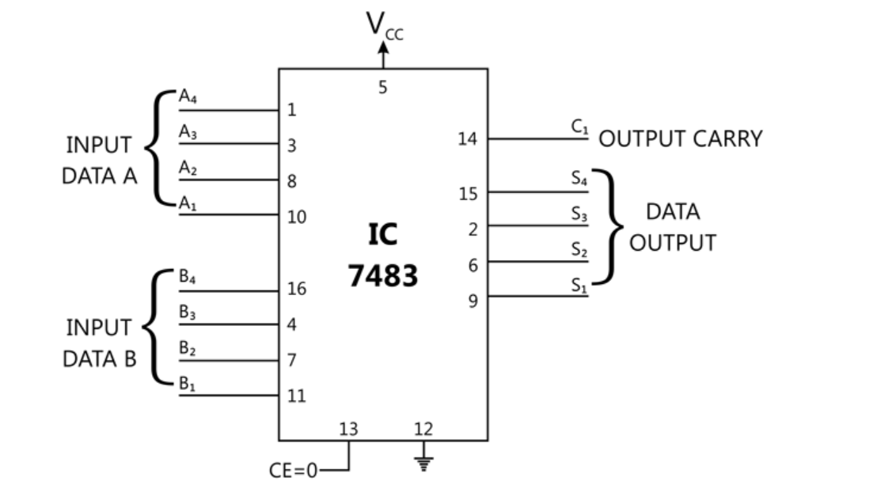
4 bit adder IC 7483

Slide 15
Controlled Adder Subtractor
Circuit which can be Controlled as adder as well as subtractor
If control input C = 0 …Adder
If Control input C = 1 …Subtractor
Addition Subtraction: by 2’s complement
1’s complement of B can be obtained by 4 XOR gates as
1 xor A = A’ , 0 xor A = A
 | A3 | A2 | A1 | A0
+ | B3 | B2 | B1 | B0
C3 | C2 | C1 | C0
Cout | S3 | S2 | S1 | S0
 | A3 | A2 | A1 | A0
+ | B3’ | B2’ | B1’ | B0’
C3 | C2 | C1 | C0 | 1
Cout | S3 | S2 | S1 | S0

Slide 16
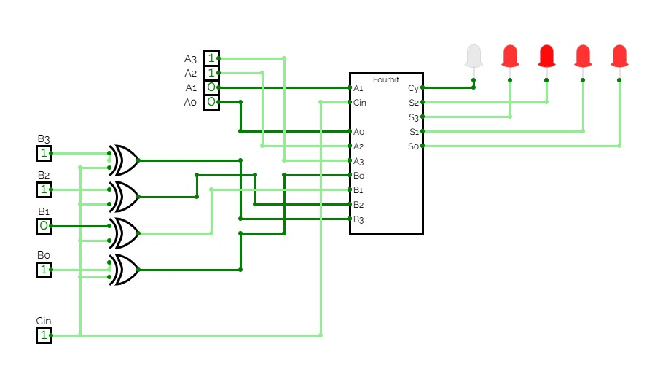
Controlled Adder Subtractor

Slide 17
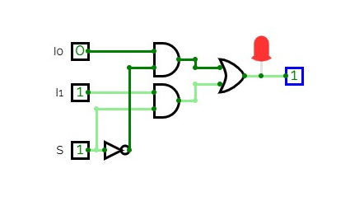
2:1 Multiplexers
Y = S0’.I0 + S0. I1
S0 | Y
0 | I0
1 | I1

Slide 18
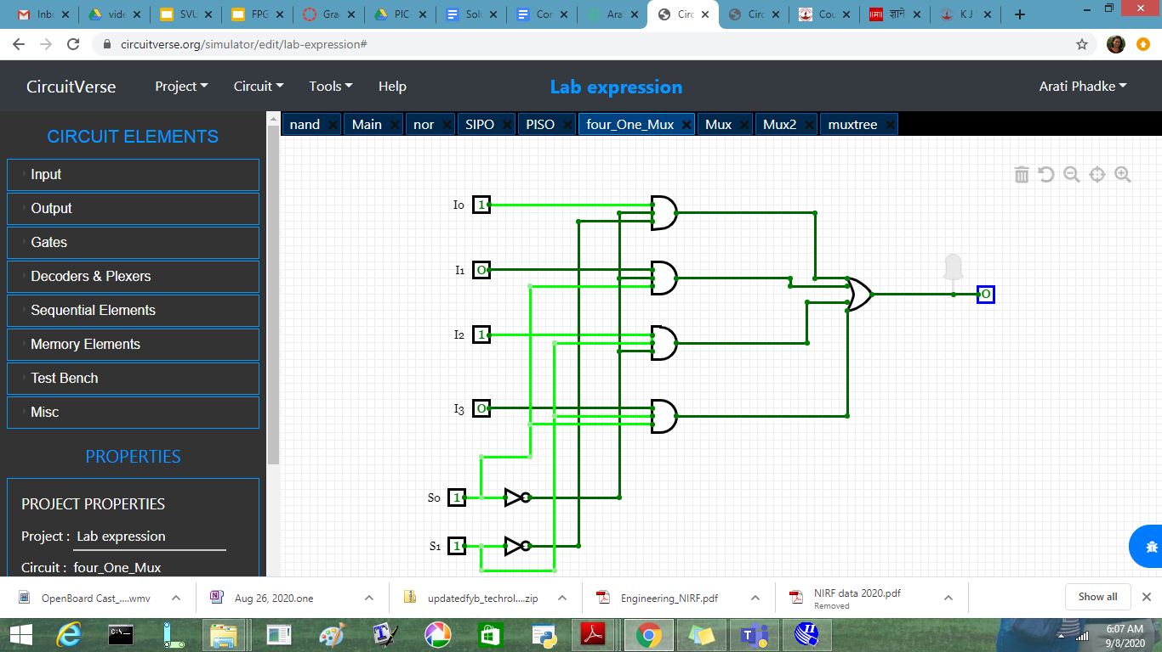
4:1 Multiplexers
4:1 Multiplexer
Y = S1’.S0’.I0 + S1’.S0.I1+S1.S0’.I2+S1.S0.I3
S1 | S0 | Y
0 | 0 | I0
0 | 1 | I1
1 | 0 | I2
1 | 1 | I3

Slide 19
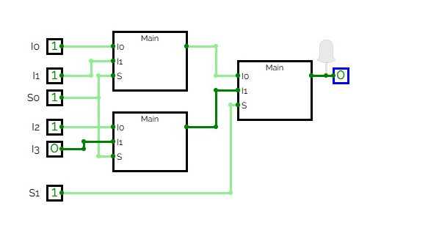
4:1 Multiplexers using 2:1 Mux
4:1 Multiplexer
Y = S1’.S0’.I0 + S1’.S0.I1+S1.S0’.I2+S1.S0.I3
S1 | S0 | Y
0 | 0 | I0
0 | 1 | I1
1 | 0 | I2
1 | 1 | I3

Slide 20
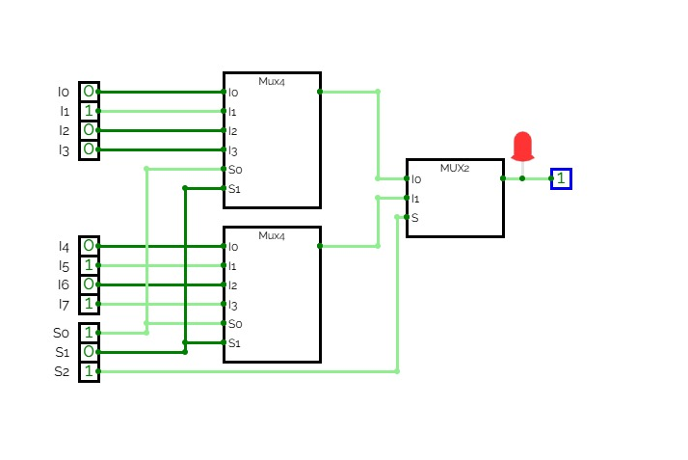
Multiplexer Tree : 8:1 using 4:1 Mux

Slide 21
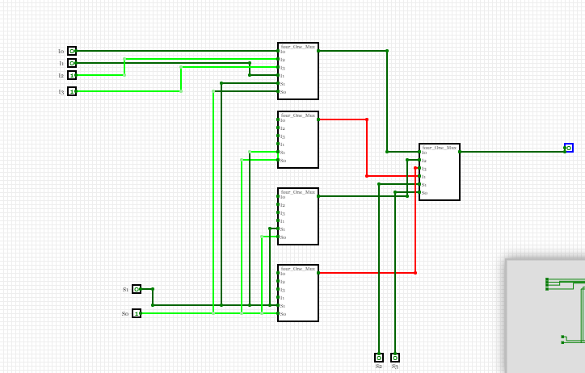
Multiplexer Tree …16:1 using 4:1 Mux

Slide 22
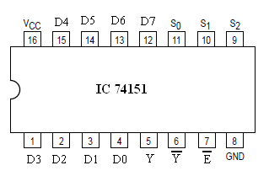
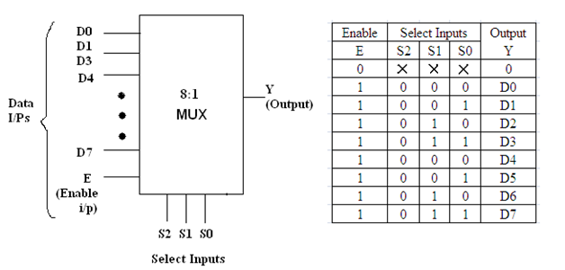
Multiplexers 8:1 : IC 74151

Slide 23
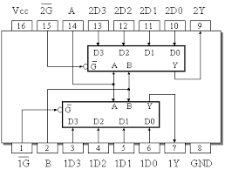
Dual 4:1 Mux IC 74153
Truth Table
Inputs |  |  | Output
B | A | G’ | Y
X | X | 1 | 0
0 | 0 | 0 | D0
0 | 1 | 0 | D1
1 | 0 | 0 | D2
1 | 1 | 0 | D3

Slide 24
Decoder
Truth table Minterm Generator
O0=D1’D0’
O1 = D1’D0
O2 = D1D0’
O3 = D1D0
D1 | D0 | O3 | O2 | O1 | O0
0 | 0 | 0 | 0 | 0 | 1
0 | 1 | 0 | 0 | 1 | 0
1 | 0 | 0 | 1 | 0 | 0
1 | 1 | 1 | 0 | 0 | 0

Slide 25
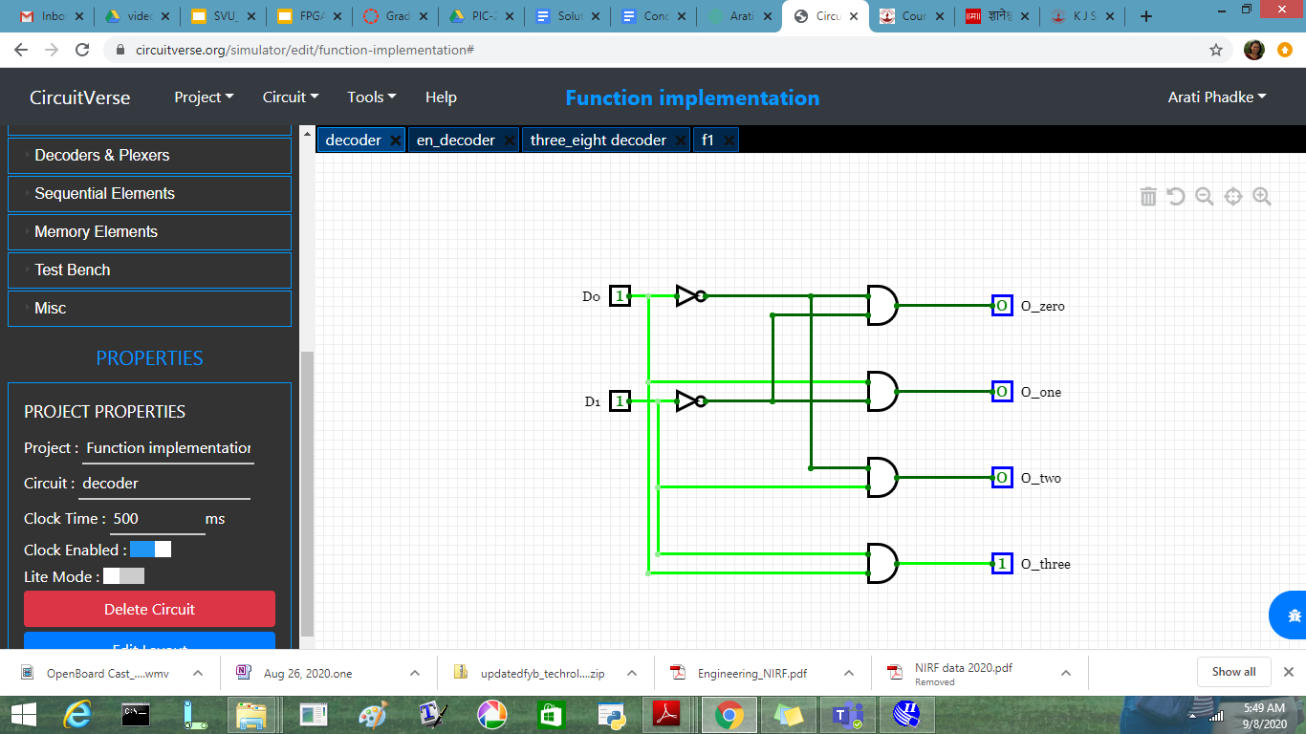
2:4 Decoder

Slide 26
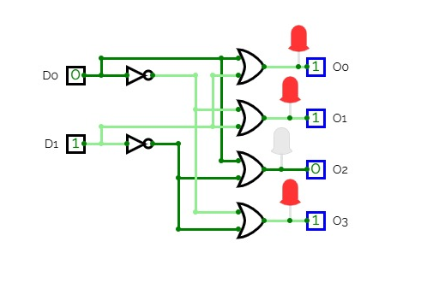
Decoder with active low output
Maxterm Generator
O0= ( D1+D0)
O1 = (D1+D0’)
O2 = (D1’+D0)
O3 = (D1’+D0’)
D1 | D0 | O3 | O2 | O1 | O0
0 | 0 | 1 | 1 | 1 | 0
0 | 1 | 1 | 1 | 0 | 1
1 | 0 | 1 | 0 | 1 | 1
1 | 1 | 0 | 1 | 1 | 1

Slide 27
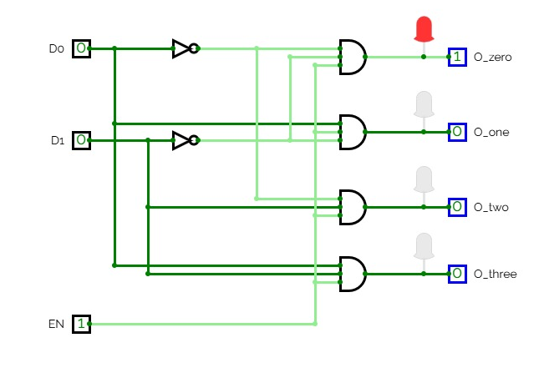
Decoder with enable input
Minterm Generator
O0= En.D1’D0’
O1 = En.D1’D0
O2 = En.D1D0’
O3 = En.D1D0
En | D1 | D0 | O3 | O2 | O1 | O0
0 | X | X | 0 | 0 | 0 | 0
1 | 0 | 0 | 0 | 0 | 0 | 1
1 | 0 | 1 | 0 | 0 | 1 | 0
1 | 1 | 0 | 0 | 1 | 0 | 0
1 | 1 | 1 | 1 | 0 | 0 | 0

Slide 28
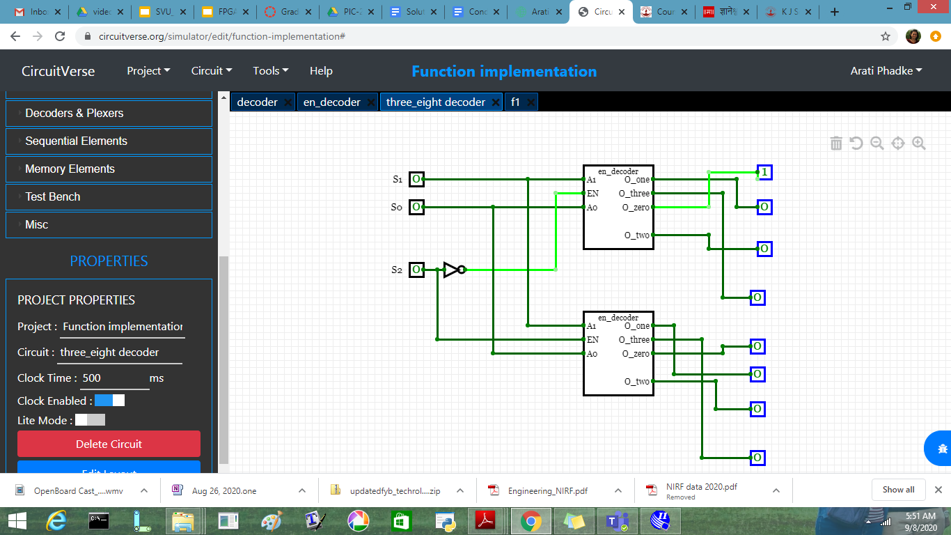
Decoder Tree 3:8 decoder using 2:4

Slide 29
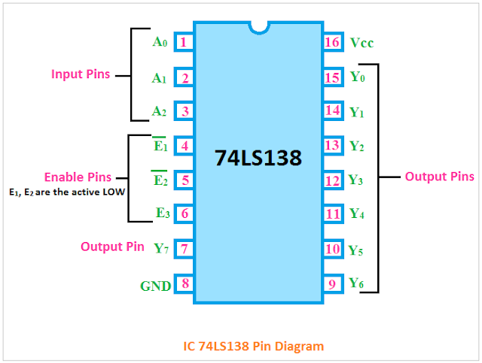
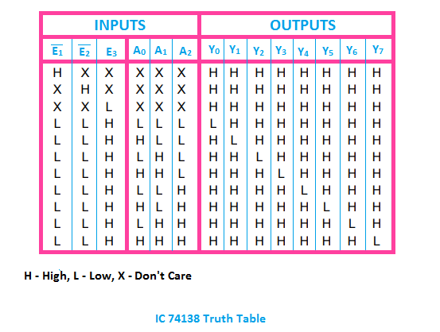
IC 74138: 3:8 Decoder

Slide 30
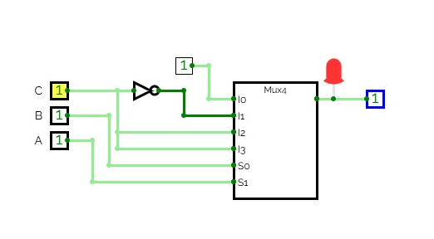
Function Implementation using Multiplexer
F= Σm(0,1,2,5,7)
A | B | C | Y
0 | 0 | 0 | 1 | 1
0 | 0 | 1 | 1
0 | 1 | 0 | 1 | C’
0 | 1 | 1 | 0
1 | 0 | 0 | 0 | C
1 | 0 | 1 | 1
1 | 1 | 0 | 0 | C
1 | 1 | 1 | 1

Slide 31
Function Implementation using Multiplexer
F= Σm(0,2,5,7,8,10,13,15)
Implement using
8: 1 mux
Implement using
4:1 mux
Using 8:1 Mux
ABC are select Lines
A | B | C | D | F
0 | 0 | 0 | 0 | 1 | D’
0 | 0 | 0 | 1 | 0
0 | 0 | 1 | 0 | 1 | D’
0 | 0 | 1 | 1 | 0
0 | 1 | 0 | 0 | 0 | D
0 | 1 | 0 | 1 | 1
0 | 1 | 1 | 0 | 0 | D
0 | 1 | 1 | 1 | 1
A | B | C | D | F
1 | 0 | 0 | 0 | 1 | D’
1 | 0 | 0 | 1 | 0
1 | 0 | 1 | 0 | 1 | D’
1 | 0 | 1 | 1 | 0
1 | 1 | 0 | 0 | 0 | D
1 | 1 | 0 | 1 | 1
1 | 1 | 1 | 0 | 0 | D
1 | 1 | 1 | 1 | 1

Slide 32
Function Implementation using Multiplexer
F= Σm(0,2,5,7,8,10,13,15)
Implement using 4:1 mux
Use select Lines as AB
AB / CD | 00 | 01 | 10 | 11
00 | 1 |  | 1
01 |  | 1 |  | 1
10 | 1 |  | 1
11 |  | 1 |  | 1
 | D’ | D | D’ | D

Slide 33
Function Implementation using Multiplexer
F= Σm(0,1,4,6,8,10,12,15)
Implement using 8: 1 mux
Implement using 4:1 mux
Using 8:1 Mux
ABC are select Lines
A | B | C | D | F
0 | 0 | 0 | 0
0 | 0 | 0 | 1
0 | 0 | 1 | 0
0 | 0 | 1 | 1
0 | 1 | 0 | 0
0 | 1 | 0 | 1
0 | 1 | 1 | 0
0 | 1 | 1 | 1
A | B | C | D | F
1 | 0 | 0 | 0
1 | 0 | 0 | 1
1 | 0 | 1 | 0
1 | 0 | 1 | 1
1 | 1 | 0 | 0
1 | 1 | 0 | 1
1 | 1 | 1 | 0
1 | 1 | 1 | 1

Slide 34
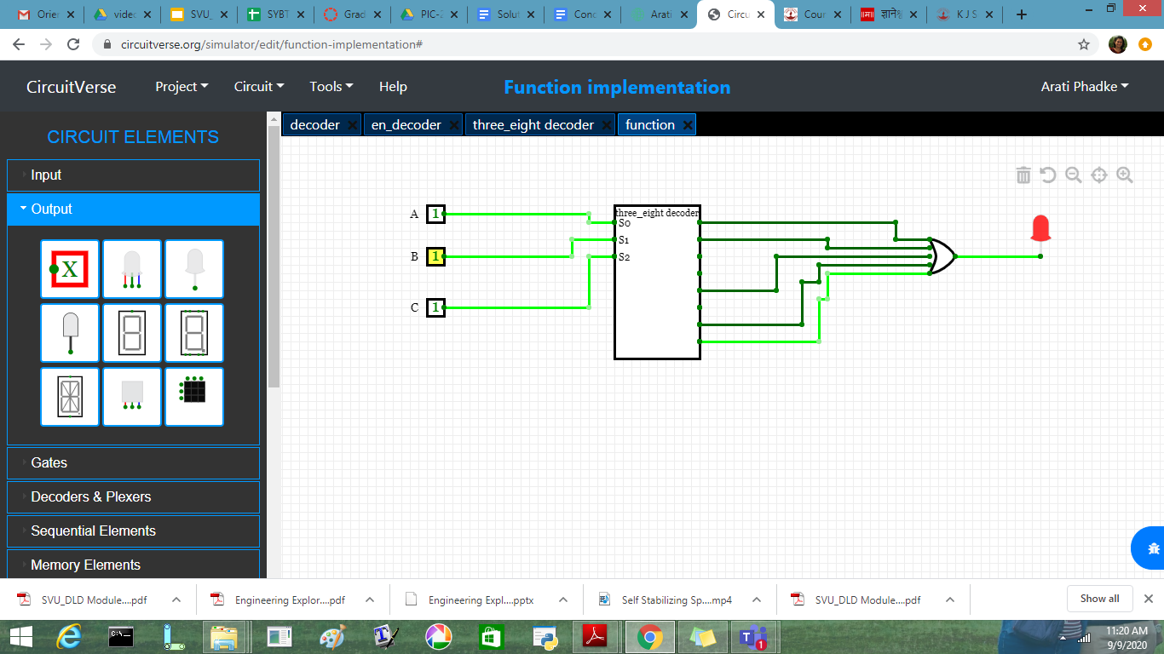
Function Implementation using Decoder
F= Σm(0,1,4,6, 7)
Implement using 3: 8 decoder( Active High Output)

Slide 35
Function Implementation using Decoder
F= Σm(0,1,4,6,8,10,12,15)
Implement 4: 16 decoder

Slide 36
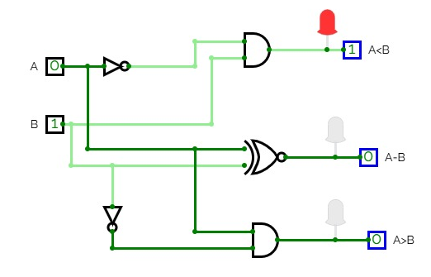
1 bit Comparator
(A<B) = A’B
( A=B) = A XNOR B
(A>B) = AB’
A | B | A<B | A=B | A>B
0 | 0 | 0 | 1 | 0
0 | 1 | 1 | 0 | 0
1 | 0 | 0 | 0 | 1
1 | 1 | 0 | 1 | 0

Slide 37
2 bit Comparator
A1 | A0 | B1 | B0 | A<B | A=B | A>B
0 | 0 | 0 | 0 | 0 | 1 | 0
0 | 0 | 0 | 1 | 1 | 0 | 0
0 | 0 | 1 | 0 | 1 | 0 | 0
0 | 0 | 1 | 1 | 1 | 0 | 0
0 | 1 | 0 | 0 | 0 | 0 | 1
0 | 1 | 0 | 1 | 0 | 1 | 0
0 | 1 | 1 | 0 | 1 | 0 | 0
0 | 1 | 1 | 1 | 1 | 0 | 0
A1 | A0 | B1 | B0 | A<B | A=B | A>B
1 | 0 | 0 | 0 | 0 | 0 | 1
1 | 0 | 0 | 1 | 0 | 0 | 1
1 | 0 | 1 | 0 | 0 | 1 | 0
1 | 0 | 1 | 1 | 1 | 0 | 0
1 | 1 | 0 | 0 | 0 | 0 | 1
1 | 1 | 0 | 1 | 0 | 0 | 1
1 | 1 | 1 | 0 | 0 | 0 | 1
1 | 1 | 1 | 1 | 0 | 1 | 0

Slide 38
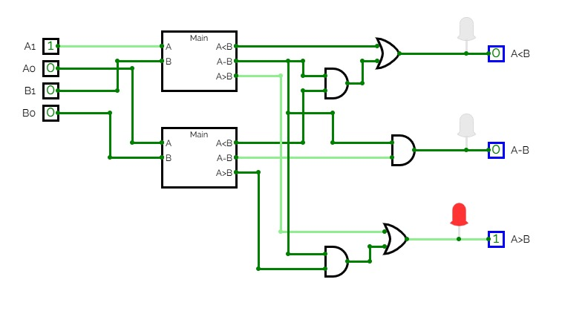
2 bit Comparator

Slide 39
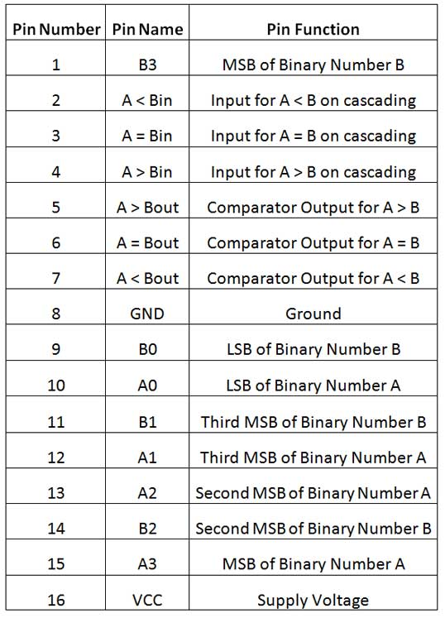
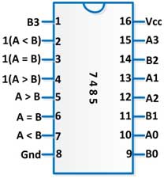
4 bit Comparator
IC 7485 comparator

Slide 40
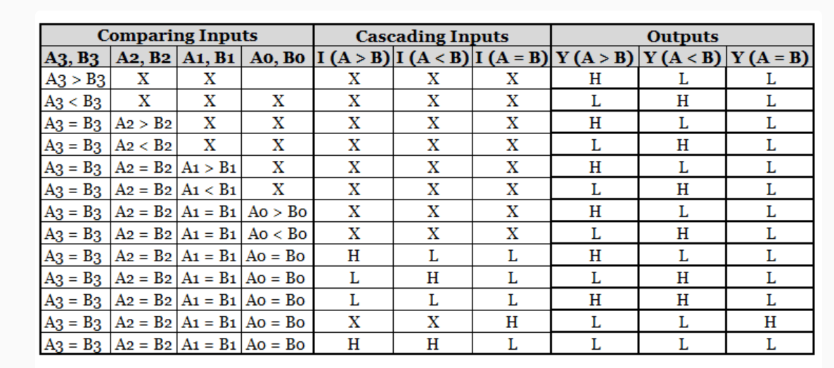
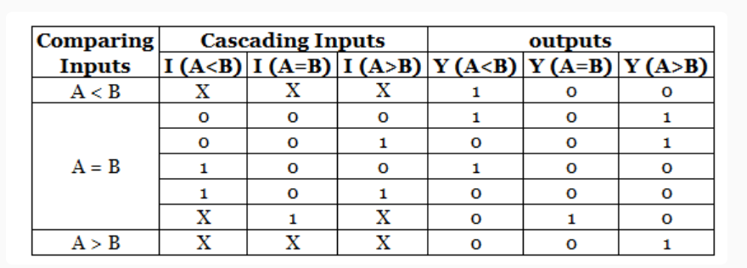
4 bit Comparator

Slide 41
Encoders

Slide 42
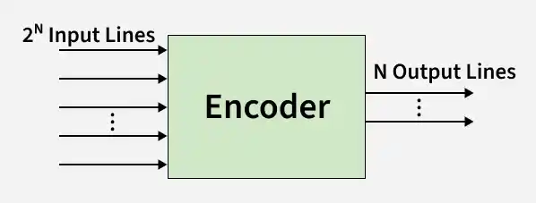
Definition
An encoder is a combinational circuit that converts 2ⁿ input lines into n output lines. Only one input should be HIGH (1) at a time.
Example:
4-to-2 encoder → 4 inputs, 2 outputs
8-to-3 encoder → 8 inputs, 3 outputs
Example: 4-to-2 Encoder
Inputs: Y0, Y1, Y2, Y3 Outputs: A1, A0
Active Input | A1 | A0
Y0 = 1 | 0 | 0
Y1 = 1 | 0 | 1
Y2 = 1 | 1 | 0
Y3 = 1 | 1 | 1

Slide 43
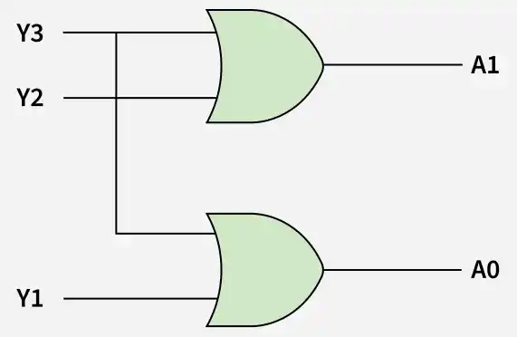
Boolean Expressions:
A1 = Y2 + Y3
A0=Y1+Y3
Applications:
Keyboard encoding
Interrupt handling
Data compression
Microprocessor input systems

Slide 44
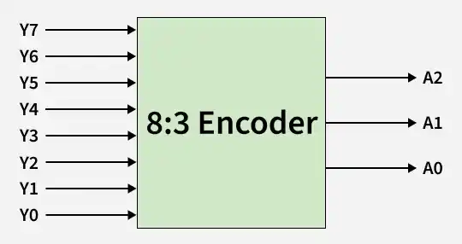
Octal to Binary Encoder (8 to 3 Encoder)
The 8 to 3 Encoder or octal to Binary encoder consists of 8 inputs: Y7 to Y0 and 3 outputs: A2, A1 & A0. Each input line corresponds to each octal digit value and three outputs generate corresponding binary code.
The figure below shows the logic symbol of octal to the binary encoder.

Slide 45
Truth Table
INPUTS(Y₇Y₆Y₅Y₄Y₃Y₂Y₁Y₀) | OUTPUTS(A₂A₁A₀)
00000001 | 000
00000010 | 001
00000100 | 010
00001000 | 011
00010000 | 100
00100000 | 101
01000000 | 110
10000000 | 111

Slide 46
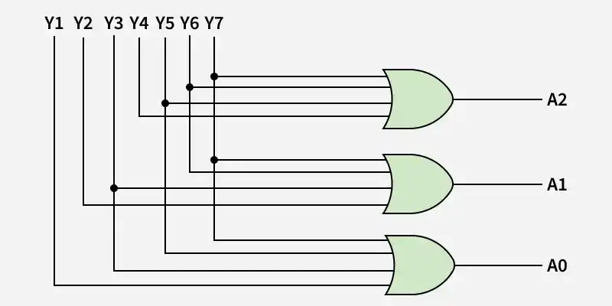
Logical expression for A₂, A₁, and A₀:
A₂ = Y₇ + Y₆ + Y₅ + Y₄ A₁ = Y₇ + Y₆ ₊ Y₃ + Y₂ A₀ = Y₇ + Y₅ + Y₃ + Y₁

Slide 47
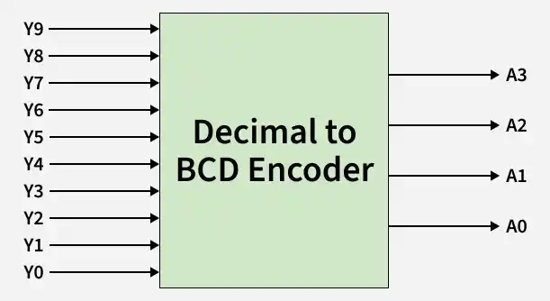
Decimal to BCD Encoder (16:4)
The decimal-to-binary encoder usually consists of 16 input lines and 4 output lines. Each input line corresponds to each decimal digit and 4 outputs correspond to the BCD code. This encoder accepts the decoded decimal data as an input and encodes it to the BCD output which is available on the output lines. The figure below shows the logic symbol of the decimal to BCD encoder.

Slide 48
Truth Table
INPUTS(Y₉Y₈Y₇Y₆Y₅Y₄Y₃Y₂Y₁Y₀) | OUTPUTS(A₃A₂A₁A₀)
0000000001 | 0000
0000000010 | 0001
0000000100 | 0010
0000001000 | 0011
0000010000 | 0100
0000100000 | 0101
0001000000 | 0110
0010000000 | 0111
0100000000 | 1000
1000000000 | 1001

Slide 49
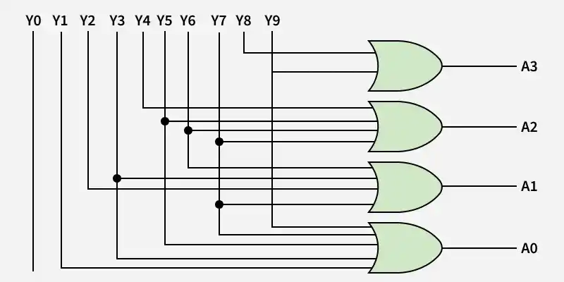
Logical expression for A3, A2, A1, and A0:
A3 = Y15+Y14+Y13+Y12+Y11+Y10+Y9 + Y8 A2 = Y15+Y14+Y13+Y12+Y7 + Y6 + Y5 +Y4 A1 = Y15+Y14+Y11+Y10+Y7 + Y6 + Y3 +Y2 A0 = Y15+Y13_Y11+Y9 + Y7 +Y5 +Y3 + Y1
Circuit Diagram
The above two Boolean functions can be implemented using OR gates:

Slide 50
Priority Encoders

Slide 51
Definition
A priority encoder is an encoder that assigns priority to inputs.
If multiple inputs are HIGH at the same time, the encoder outputs the code of the highest priority input.
Usually, the highest-numbered input has the highest priority. A 4 to 2 priority encoder has 4 inputs: Y₃, Y₂, Y₁ & Y₀, and 2 outputs: A₁ & A₀. Here, the input, Y₃ has the highest priority, whereas the input, Y₀ has the lowest priority. In this case, even if more than one input is ‘1’ at the same time, the output will be the (binary) code corresponding to the input, which is having higher priority.
Example: 4-to-2 Priority Encoder
Priority Order: Y3 > Y2 > Y1 > Y0
(x = don’t care)
Inputs | Output (A1 A0)
1xxx | 11
01xx | 10
001x | 01
0001 | 00

Slide 52
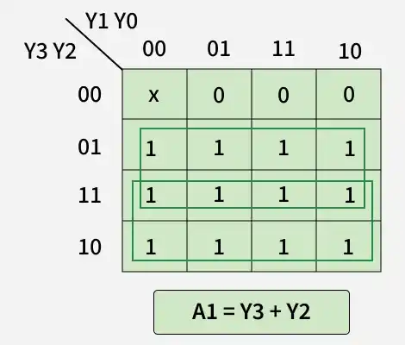
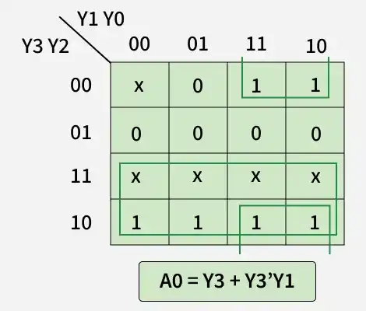
Logical Expressions using K-Map
The logical expression for A₁ is shown below:
The Logical Expression for A0 is shown below:

Slide 53
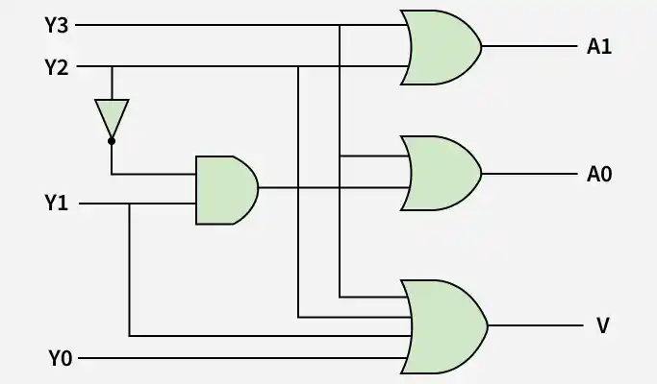
Circuit Diagram: The above two Boolean functions can be implemented as:
Applications of Priority Encoder:
Interrupt controllers
CPU scheduling
Bus arbitration
Resource allocation systems

Slide 54
De- multiplexer (DEMUX)

Slide 55
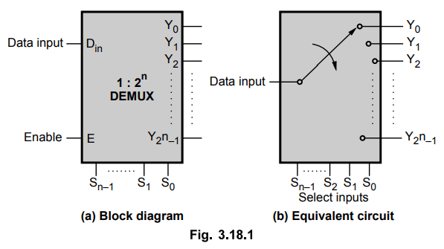
De-multiplexer (DEMUX)
The DEMUX is a digital information processor. It takes input from one source and also converts the data to transmit towards various sources. The demultiplexer has one data input line.
The demultiplexer has several control lines (also known as select lines). These lines determine to which output the input data should be sent. The number of control lines determines the number of output lines.

Slide 56
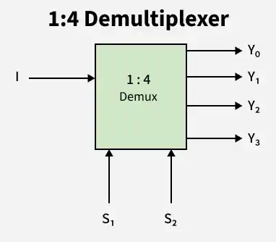
Truth Table Of A 1X4 DEMUX
A 1x4 DEMUX has only one input which is denoted as I. There are two selection lines i.e. S1 and S0. At last, the DEMUX has output lines including Y3, Y2, Y1 &Y0. Here is the 1x4 DEMUX with diagram as mentioned below.

Slide 57
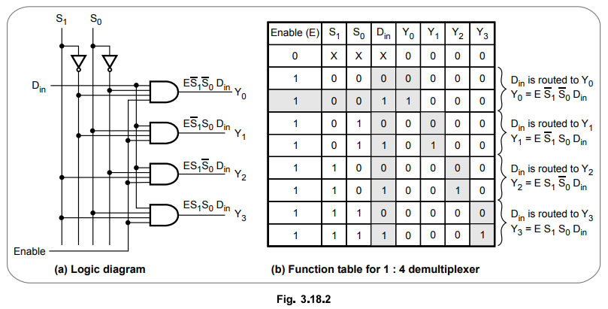

Slide 58
Truth Table Of A 1x8 De-Multiplexer
The 1x8 DEMUX was designed by using two DEMUX. They are the two 1x4 DEMUX and one 1x2 DEMUX. The 1x8 DEMUX contains two input lines with four outputs. Let us see the block diagram of the 1x8 DEMUX as mentioned below.

Slide 59
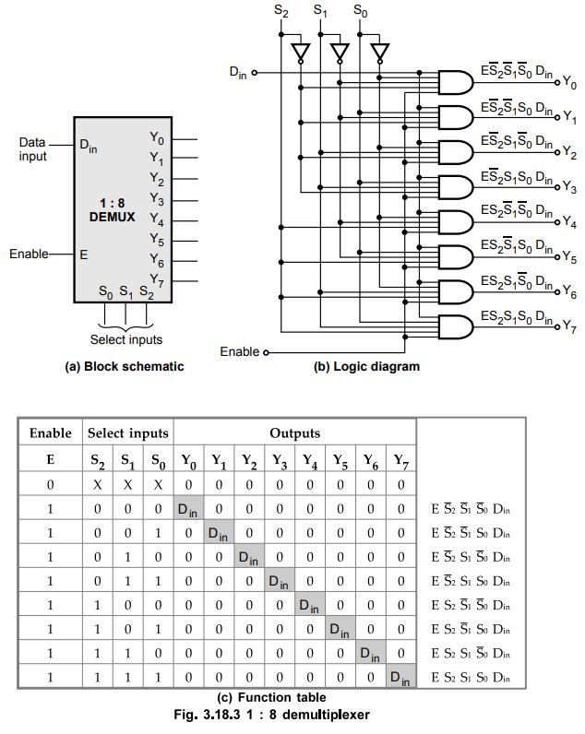

Slide 60
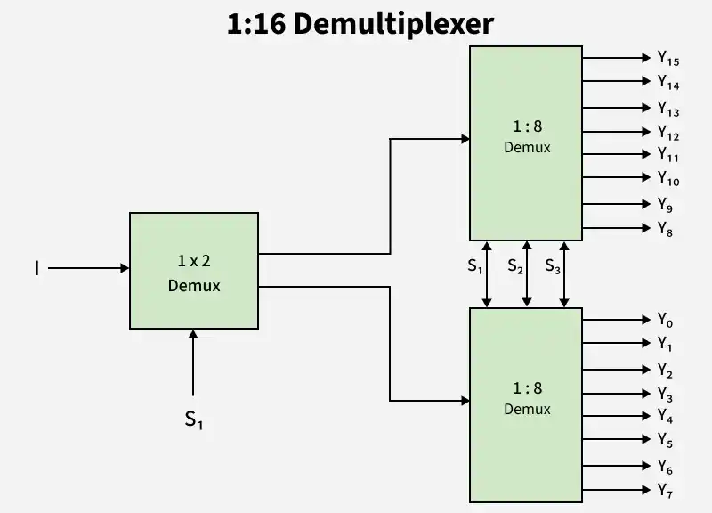
Truth Table Of A 1x16 De-Multiplexer
The 1x16 DEMUX was designed by using the two 1x8 DEMUX and one 1x2 DEMUX. The 1x16 DEMUX have two input lines. It has eight outputs. Let us see the block diagram of the 1x16 DEMUX as mentioned below.

Slide 61
SELECTION INPUTS |  |  |  | OUTPUTS
S₃ | S₂ | S₁ | S₀ | Y₁₅ | Y₁₄ | Y₁₃ | Y₁₂ | Y₁₁ | Y₁₀ | Y₉ | Y₈ | Y₇ | Y₆ | Y₅ | Y₄ | Y₃ | Y₂ | Y₁ | Y₀
0 | 0 | 0 | 0 | 0 | 0 | 0 | 0 | 0 | 0 | 0 | 0 | 0 | 0 | 0 | 0 | 0 | 0 | 0 | A
0 | 0 | 0 | 1 | 0 | 0 | 0 | 0 | 0 | 0 | 0 | 0 | 0 | 0 | 0 | 0 | 0 | 0 | A | 0
0 | 0 | 1 | 0 | 0 | 0 | 0 | 0 | 0 | 0 | 0 | 0 | 0 | 0 | 0 | 0 | 0 | A | 0 | 0
0 | 0 | 1 | 1 | 0 | 0 | 0 | 0 | 0 | 0 | 0 | 0 | 0 | 0 | 0 | 0 | A | 0 | 0 | 0
0 | 1 | 0 | 0 | 0 | 0 | 0 | 0 | 0 | 0 | 0 | 0 | 0 | 0 | 0 | A | 0 | 0 | 0 | 0
0 | 1 | 0 | 1 | 0 | 0 | 0 | 0 | 0 | 0 | 0 | 0 | 0 | 0 | A | 0 | 0 | 0 | 0 | 0
0 | 1 | 1 | 0 | 0 | 0 | 0 | 0 | 0 | 0 | 0 | 0 | 0 | A | 0 | 0 | 0 | 0 | 0 | 0
0 | 1 | 1 | 1 | 0 | 0 | 0 | 0 | 0 | 0 | 0 | 0 | A | 0 | 0 | 0 | 0 | 0 | 0 | 0
1 | 0 | 0 | 0 | 0 | 0 | 0 | 0 | 0 | 0 | 0 | A | 0 | 0 | 0 | 0 | 0 | 0 | 0 | 0
1 | 0 | 0 | 1 | 0 | 0 | 0 | 0 | 0 | 0 | A | 0 | 0 | 0 | 0 | 0 | 0 | 0 | 0 | 0
1 | 0 | 1 | 0 | 0 | 0 | 0 | 0 | 0 | A | 0 | 0 | 0 | 0 | 0 | 0 | 0 | 0 | 0 | 0
1 | 0 | 1 | 1 | 0 | 0 | 0 | 0 | A | 0 | 0 | 0 | 0 | 0 | 0 | 0 | 0 | 0 | 0 | 0
1 | 1 | 0 | 0 | 0 | 0 | 0 | A | 0 | 0 | 0 | 0 | 0 | 0 | 0 | 0 | 0 | 0 | 0 | 0
1 | 1 | 0 | 1 | 0 | 0 | A | 0 | 0 | 0 | 0 | 0 | 0 | 0 | 0 | 0 | 0 | 0 | 0 | 0
1 | 1 | 1 | 0 | 0 | A | 0 | 0 | 0 | 0 | 0 | 0 | 0 | 0 | 0 | 0 | 0 | 0 | 0 | 0
1 | 1 | 1 | 1 | A | 0 | 0 | 0 | 0 | 0 | 0 | 0 | 0 | 0 | 0 | 0 | 0 | 0 | 0 | 0

Slide 62
Ex. 3.18.1 Design 1 : 8 demultiplexer using two 1 : 4 demultiplexers.

Slide 63
Step 1 : Connect Din signal to Din input of both the demultiplexers.
Step 2 : Connect select lines B and C to select lines S1 and S0 of the both demultiplexers, respectively.
Step 3 : Connect most significant select line (A) such that when A = 0 DEMUX 1 is enabled and when A = 1 DEMUX 2 is enabled.

Slide 64
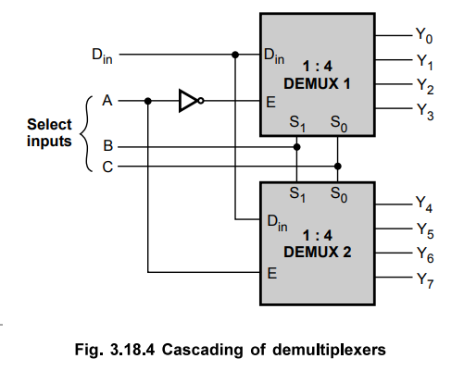

Slide 65
Implement 1 : 16 demultiplexer using 1 : 4 demultiplexers.
The 1 : 16 demultiplexer has 16 outputs. To select one of the 16 output, the circuit needs 4 (v 24 = 16) select lines. Each 1 : 4 demultiplexer requires 2 select lines.
Step 1 : Connect two least significant select lines (S1, S0) to select lines of four 4 : 1 demultiplexer.
Step 2 : Connect one more 4 : 1 demultiplexer such that its four outputs are routed to the data inputs of the four demultiplexers. Connect higher select lines (S3, S2) to the select lines of this demultiplexer.

Slide 66
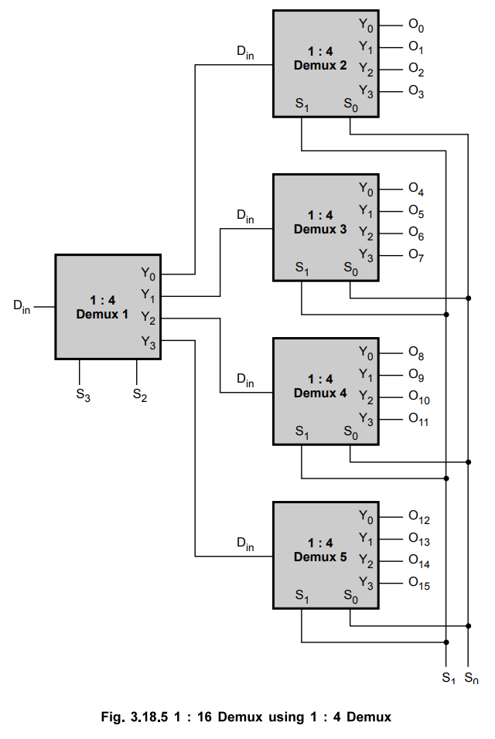

Slide 67
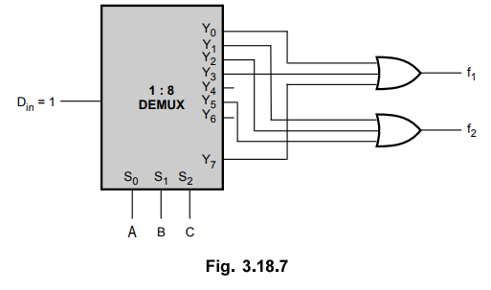
Ex. 3.18.6 Implement the following functions using demultiplexer :
f₁ (A, B, C) = ∑ m (0, 3, 7)
f₂ (A, B, C) = ∑ m (1, 2, 5)
Sol. :
f₁ (A, B, C) = ∑ m (0, 3, 7)
f₂ (A, B, C) = ∑ m (1, 2, 5)
Implementation using 1 : 8 demultiplexer.

Slide 68

Ex. 3.18.5 Implement full subtractor using demultiplexer.
Step 1 : Write the truth table of full subtractor.
Step 2 : Represent output of full-subtractors in minterm form.
For full subtractor difference D function can be written as
D = f (A, B, C) = ∑ m (1, 2, 4, 7)
and
Bout function can be written as,
Bout = F (A, B, C) = ∑ m (1, 2, 3, 7)

Slide 69

Step 3: Logically OR the outputs corresponding to minterms.
With Din input 1, demultiplexer gives minterms at the output so by logically ORing required minterms we can implement Boolean functions for full subtractor.

Slide 70
Examples for Practice:
Ex. 3.18.7 Implement full adder using demultiplexer.
Ex. 3.18.8 Implement the following functions using demultiplexer
f1 (A, B, C) = ∑ m (1, 5, 7)
f2 (A, B, C) = ∑ m (3, 6, 7)

Slide 71
Advantages of the DEMUX
The DEMUX increases the efficiency of the particular communication system as it takes data from a specific input source and distributes it to different sources.
The DEMUX helps to separate the different signals from the mixed data sources. Then it distributes these data to different sources.
DEMUX can decode the signal outputs of the multiplexer, as the system works in a reverse way of the MUX.
Disadvantages of the DEMUX
The DEMUX may cause a wastage of bandwidth as it distributes the refined data in different channels. These channels can overlap with each other which leads to the loss of signal.
The DEMUX may cause problems in the synchronization of signals. The data channels can overlap with each other which leads to the delay in the whole process.

Slide 72
Applications of DEMUX
DEMUXs are majorly used to design the ALU circuits and parallel data segments.
The DEMUXs convert the output of the MUX into the actual input. On the receiver end, the DEMUX can be used to verify the original form of the data to carry out the entire communication process.
DEMUX helps to save the output. The output generally saved to the ALU. The output will be saved in the registers and the various storage units of the system.
Each DEMUX has a connection with multiple registers which helps to store the processed data into it.
The counterpart of the DEMUX regulates the data signal at the output stage of the DEMUX operation. These data can be retrieved later to read out parallelly.
In the audio or video system, the DEMUX distributes them in different channels. In broadcasting, the DEMUX separates the composite signal into an individual one.

